Slide 1
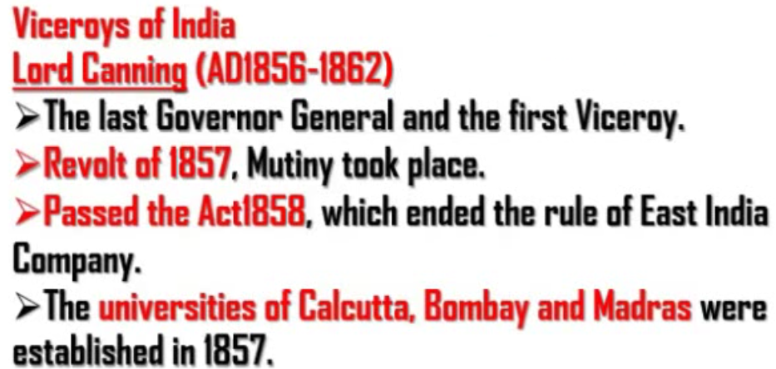
In 1856, Lord Dalhousie resigned the post of Governor General of India.
Lord Dalhousie was followed by Lord Canning in 1856.
Lord Canning was people friendly and so he was called as Mercy Canning.
In 1857, when revolt took place Canning did not crush the revolt as he was supposed to.
Till Canning, India was ruled by British East India company and not by queen of England. All those from East India Company who became the rulers were called Governor General of India.
In 1857, when revolt took place the Governor General of India who was from British East India Company, could not handle the people and crush the revolt effectively.
So, the queen of England decided to rule by herself so that power of a person ruling India will increase drastically.
Therefore, the queen of England reappointed then Governor General of India, Lord Canning as her representative and gave directions to rule India. He was then called Viceroy of India. (Viceroy – Representative of Queen of England).
Governor General of India – Representative of East India Company ruling India
Viceroy of India – Representative of Queen of England ruling India.
Lord Canning was both Governor General of India and Viceroy of India.

Slide 2
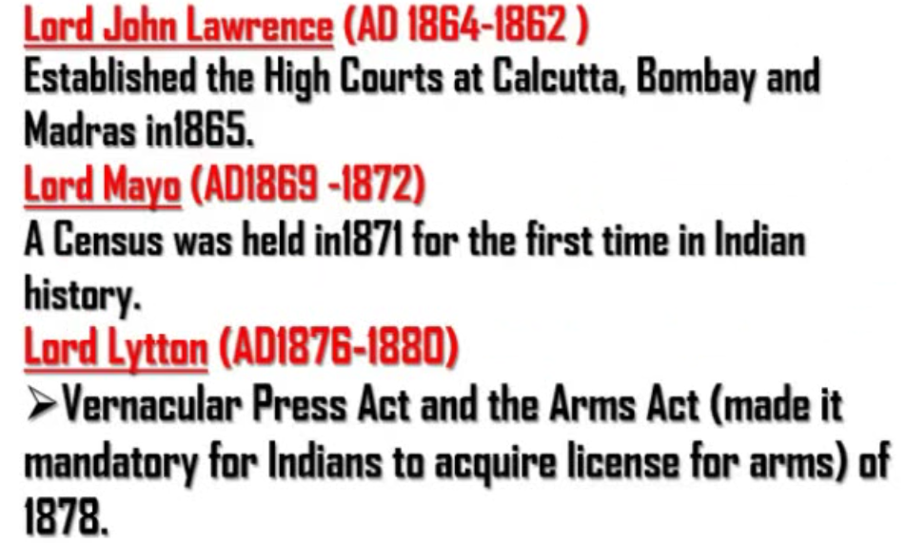
Courts – Law – Lwarence
Vernacular Press Act – Indian press should not write anything bad about British. If they did, the press was shut or British took into their custody.
Arms Act – Indians cannot acquire arms. If they wanted to acquire, they were supposed to get license.

Slide 3
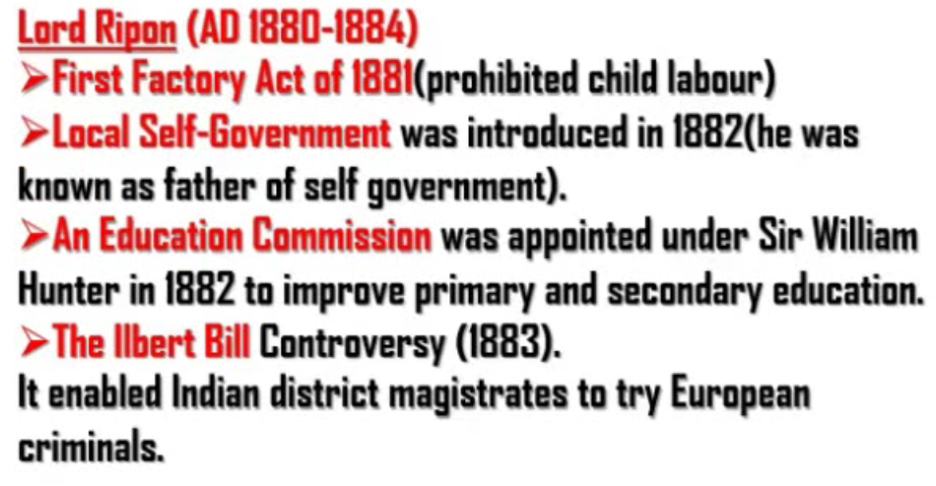
Local self gocernment – Idea of panchayati raj
Lord Ripon introduced Ilbert Bill which was controversial.
According to it, European criminals can be punished by Indian district magistrate.
try – punish

Slide 4
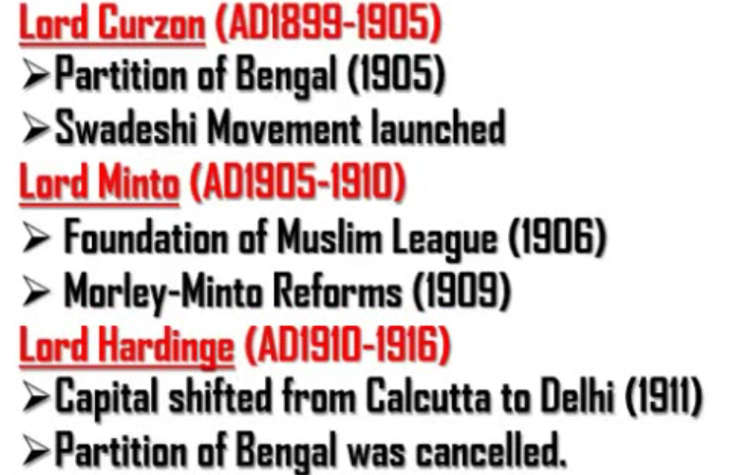
The sub points say the events happened during the period of corresponding viceroys.
The events need not be necessarily carried out by the viceroy.

Slide 5
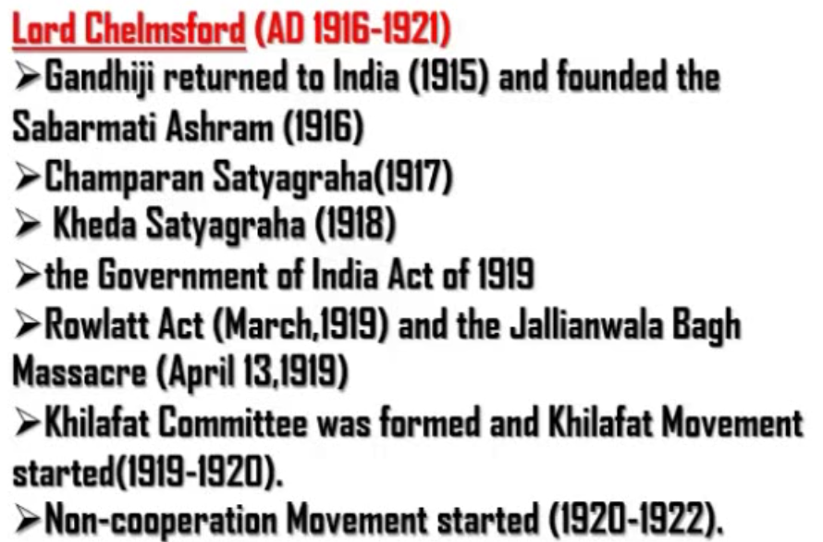
Champaran Satyaraha – Indigo Satyagraha
Rowlatt Act – According to this act, British police could arrest anyone without giving the reason.
Jallianwala Bagh Massacre – Mass killing of protestors who were protesting against Rowlatt act. Dr. Satyapal and Dr. Kichloo were mass leaders revolting against British. They were arrested for no reason under Rowlatt act. People were protesting for this incident in Jallianwala Bagh. These people were shooted according to orders of General Dier.
Non-cooperation movement – Not supporting British.
Note:
Need not remember years of all these events and movements.
It is compulsory to remember the order of all these events and movements.

Slide 6
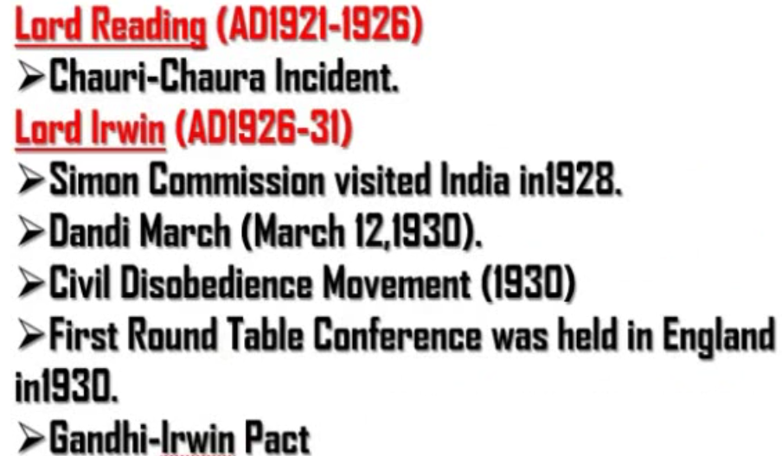
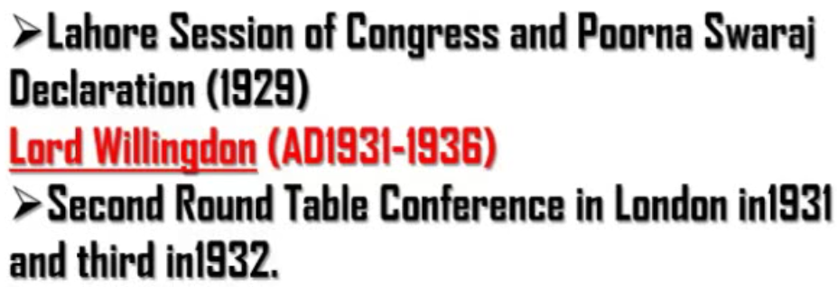
In Chauri Chaura incident 22 policemen were burnt alive in Ghorakpur, UP by the protestors.
Ghandiji came to know that protestors were turning violent due to non-cooperation movement. So he called off or took back the non-cooperation movement.
Lala Rajpat Rai in a lati charge made on the group of protesters protesting during the visit of Simon Commission
On January 26,1929 Poorna Swaraj was declared (Complete freedom)

Slide 7
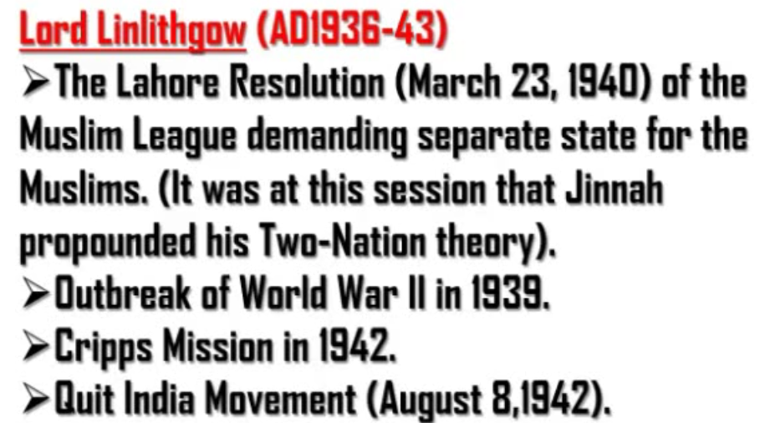

Slide 8
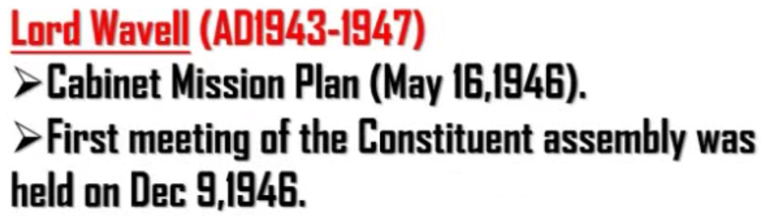

Slide 9
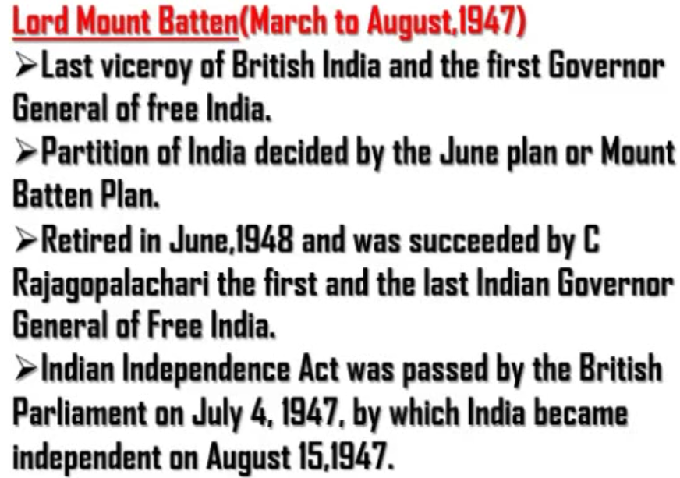
C Rajagopalachari was the first and last Indian Governor General of Free India because the rank of Governor General of Free India was removed.
Instead of that President came into being.

